Slide 1
Annual Members Meeting
13th September 2018
Halton Hospital Education Centre
Registration from 3:30pm, Presentation and Q&A 4-6pm
FREE PARKING

Slide 2
Welcome Steve McGuirk CBE DL, Chairman

Slide 3
Agenda
4:00pm Welcome, Steve McGuirk, Chairman
Happy birthday NHS – WHH Staff Choir Performance
4:05pm Annual Report 2017-18
- Chief Executive’s Report – Mel Pickup, Chief Executive
- Quality & Operational Report - Simon Constable, Executive Medical Director
Kimberley Salmon-Jamieson, Chief Nurse
- Financial Review - Andrea McGee, Director of Finance & Commercial Development
4:50pm Lead Governors’ Report Mr Norman Holding, Public Governor
5.05pm Break
5.20pm Forward plan 2018-19, Mel Pickup, Chief Executive
5:50pm Q&A session
6.00pm Close

Slide 4
Chief Executive’s Report Mel Pickup

Slide 5
Chief Executive’s Overview
Good progress in year as part of the Cheshire and Merseyside Health and Care Partnership – working towards sustainable health and social care for region
Accountable Care Partnerships established and progressing in Halton ‘One Halton’ and Warrington ‘Warrington Together’
Halton Hospital and Wellbeing Campus moves forward as part of the Halton Healthy New Town programme
A new hospital for Warrington supported

Slide 6
Chief Executive’s Overview cont.
Mortality rates in the ‘as expected’ range for the first time in years
Sepsis screening reached 100% in A&E
Infection Control rates 1 MRSA case, C-diff lowest in years
No patient waited more than six weeks for diagnostic tests
We narrowly missed the 90% 4-hour trajectory set for us by NHS Improvement
Spinal Surgery Services suspended September 2017
CQC Report received October 2017 – Requires Improvement
Made efficiency savings of £5.1m
Full year financial deficit of £14.7m, operational pressures and suspension of our spinal service meant we were unable to access full sustainability and transformation funding

Slide 7
CQC inspection 2017
Inspection March 2017, Report received October 2017
Very disappointing outcome, for patients and our staff
Immediately commenced corrective actions
Signed up to the ‘Getting to Good’ collaborative with NHSI
Board led change - aligned to Quality Improvement methodology
New WHH Strategy ‘Becoming Outstanding for our Patients, Our Staff and Our Communities’
Getting to Good, Moving to Outstanding Assurance committee established – CEO chaired
Trust-wide focus on Quality and Safety owned and embraced by all
Commissioned Listening into Action change programme
WHH is changing!
Some of our services did really well,
we will build on their success!

Slide 8
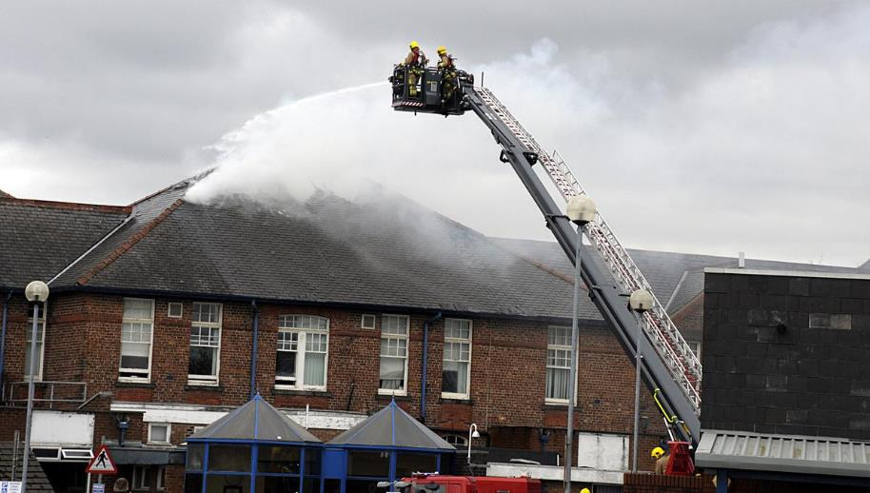
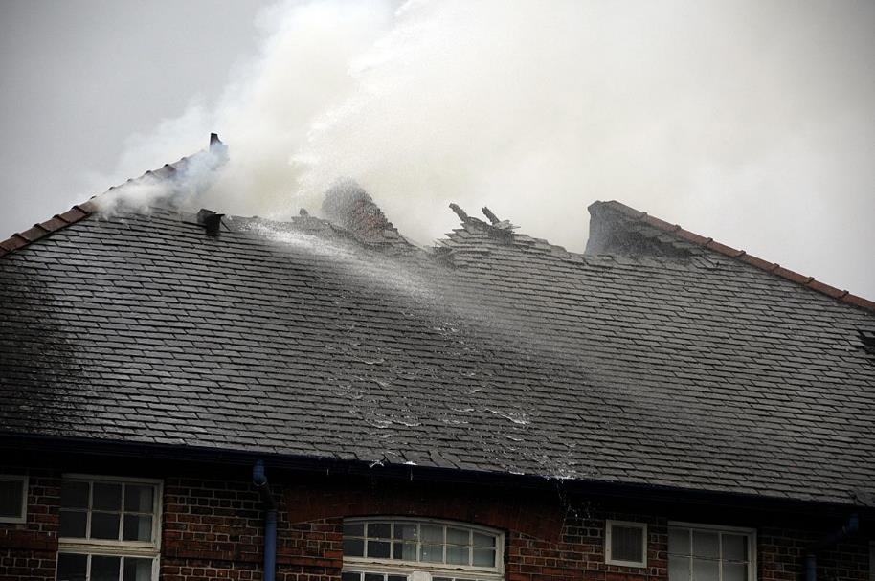
Kendrick Wing Fire
Fire detected on Friday 23rd March 2018 in roof
Safe, effective evacuation – no harm
Relocated Ophthalmology Service to Daresbury Wing, up and running within 72hrs, all patients rescheduled and seen
We still met our year end financial filing dates – well done Finance team!
Work ongoing in Kendrick Wing, restored some areas
Repairs and/or demolition work is underway
Cost of the fire and works completion dates not known yet
Forensic investigation is continuing
We are grateful to our insurers, NHS Resolution and Allianz
Thank you Cheshire Fire and Rescue Service

Slide 9
Major Investment in Technology
e-Prescribing (EPMA)
Multiple patient safety benefits
Reduction in costs due to reduction in transcription errors and adherence to the agreed medication formulary
‘Go Live’ on selected wards in 2018-19
Pharm-Outcomes – transfer of prescriptions directly to community pharmacists
Friends and Family test and Appointment reminder service by text
E-check in at Outpatients
Free patient and visitor WiFi throughout Trust

Slide 10
National recognition
ICU Team – Infection Control
Transfusion Team - Perioperative and Surgical Care
Integrated Paediatric acute response team x 2
Acute Care Team – NICE Shared Learning Awards

Slide 11
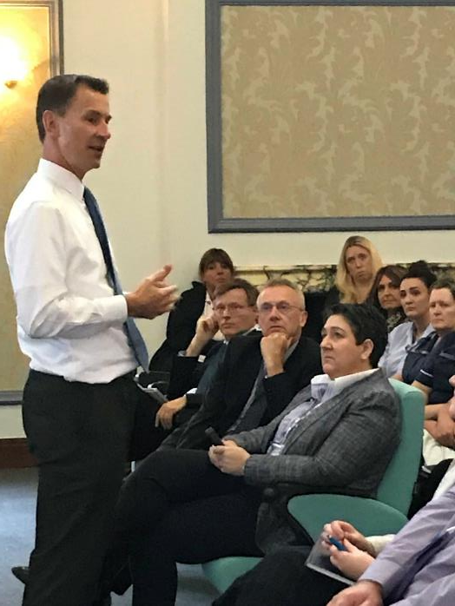
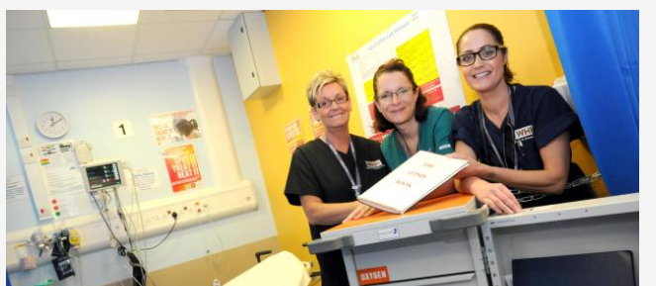
Our Sepsis Challenge success reached Whitehall..

Slide 12
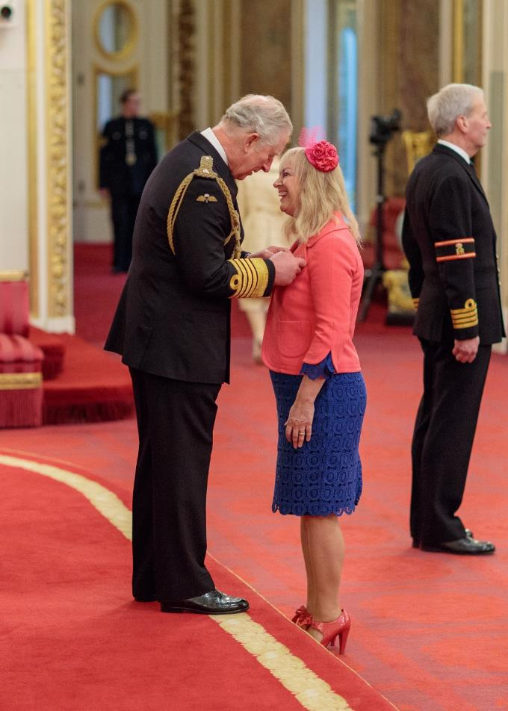
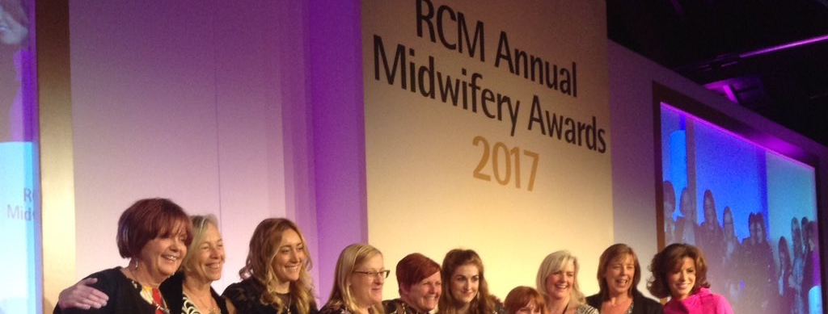
Royal Recognition
Dr Tracey Cooper received her MBE from HRH The Prince of Wales
Maternity continues to enjoy winning the RCM Maternity Service of Year award

Slide 13
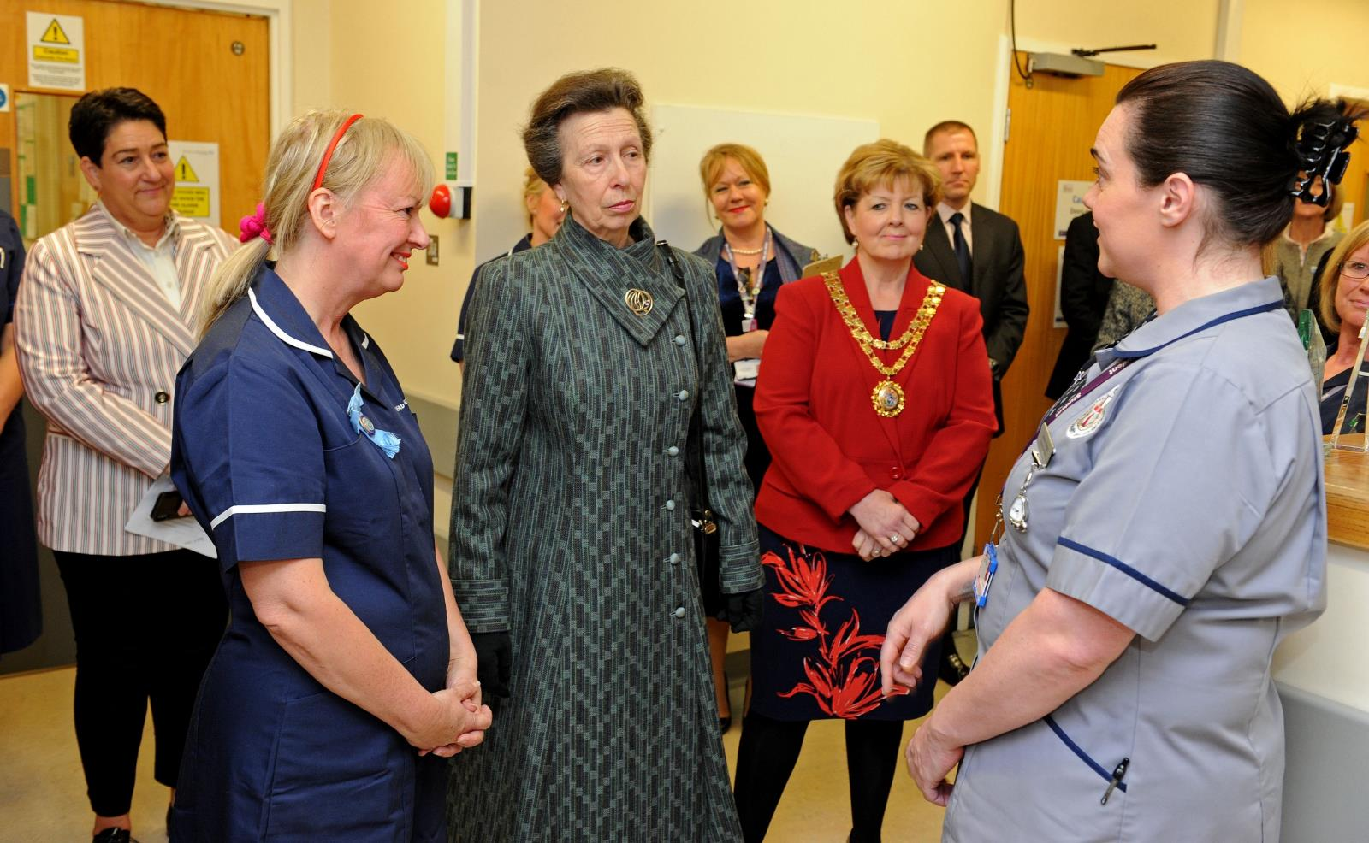
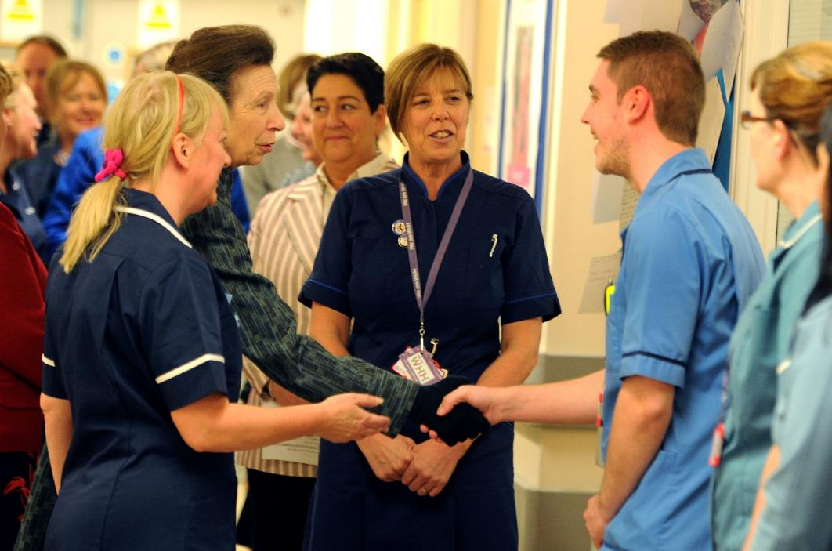

Slide 14
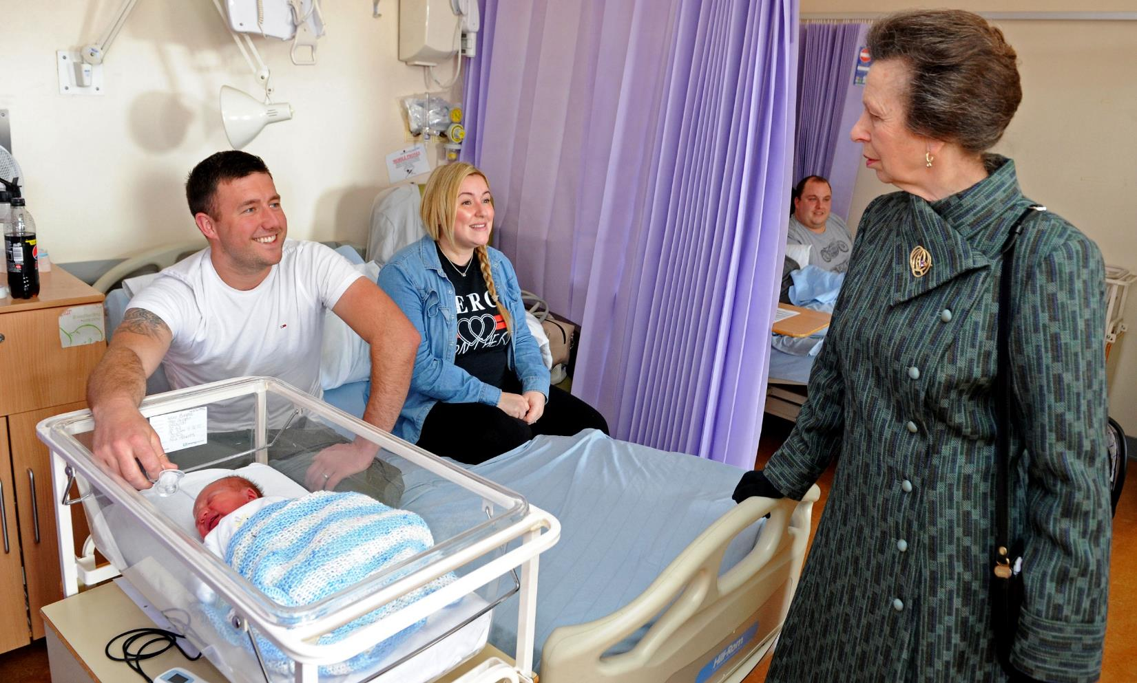

Slide 15
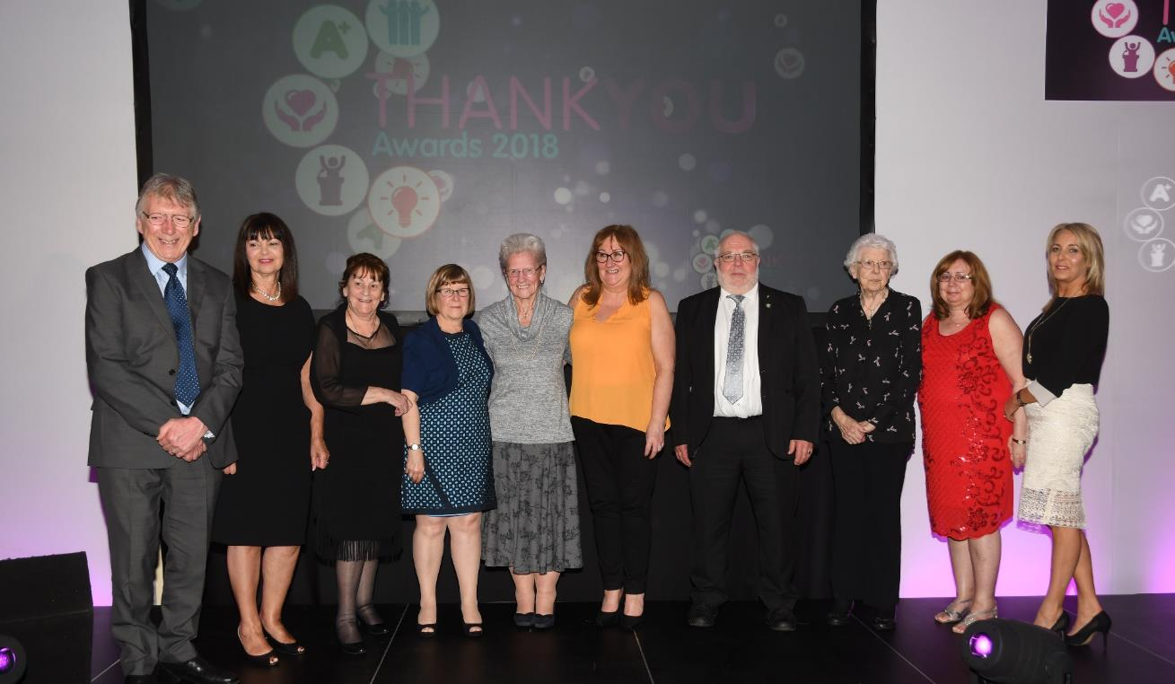
A bit closer to home…
Our amazing WHH Volunteers receive a standing ovation at our Annual Staff Awards

Slide 16
Quality & Operational Report Simon Constable, Executive Medical Director & Deputy Chief Executive Kimberley Salmon-Jamieson, Chief Nurse

Slide 17
Suspension of our Spinal Service
Service suspended in September 2017 following 4 serious, but apparently unrelated serious incidents
All WHH spinal patients care transferred to other providers
Royal College of Surgeons asked to conduct independent review
Report shared with those patients/families affected
Findings fully acknowledged, all recommendations have or are being implemented
Working with commissioners and other providers to explore spinal surgery services will be delivered in Cheshire & Merseyside in the future
Service will remain suspended until this is resolved
Our sincere apologies to all those patients and families that have been affected.

Slide 18
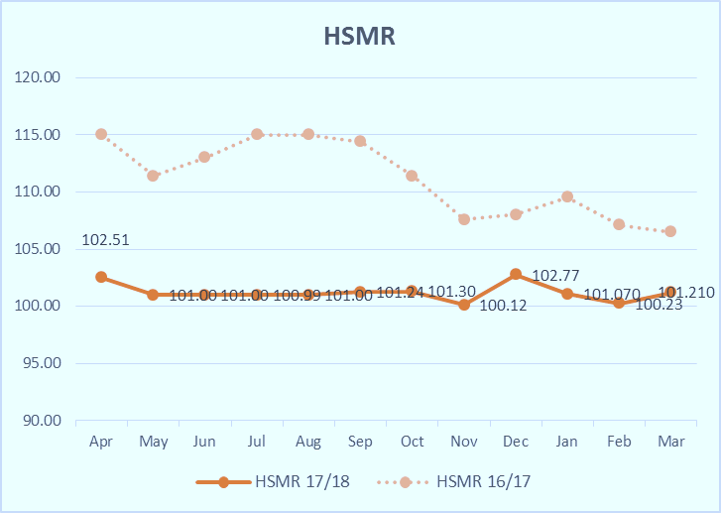
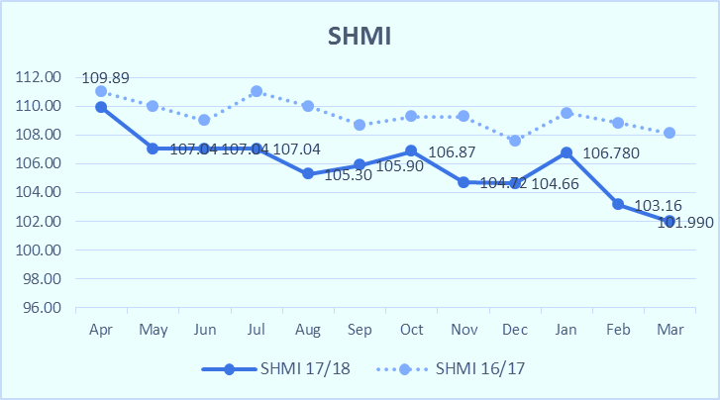
Mortality Rates – ‘as expected’
Strong, sustained performance in reducing mortality rates
Now consistently in the ‘as expected’ range for first time in years
We have implemented our new Learning from Deaths policy

Slide 19
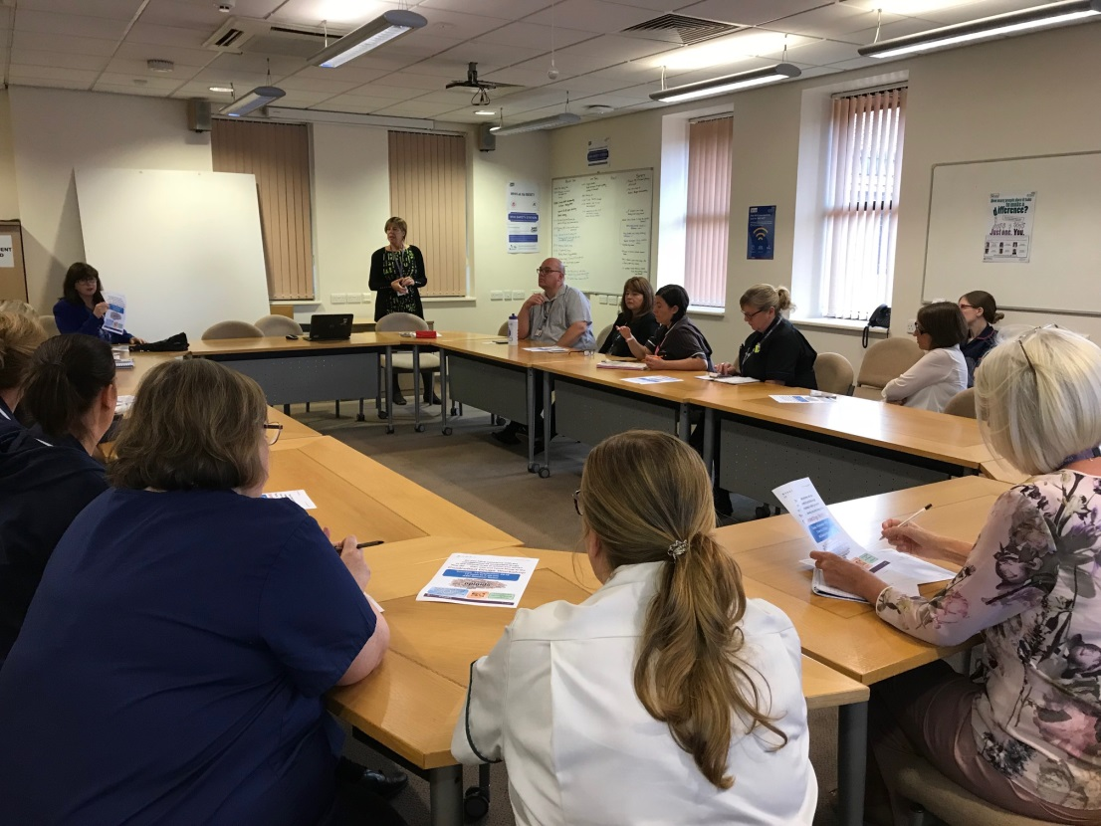
Embedding a Safety Culture
The safety culture initiative focuses on all areas, clinical and non-clinical, as all roles in the NHS contribute to delivering safe and effective care for our patients.
We have introduced a daily 15min Safety Huddle in the Boardroom which is widely and well attended
This is followed by a trust-wide Safety bulletin by email within 45mins of the briefing – this is used at ward/dept safety huddles and handovers for the following 24hrs

Slide 20
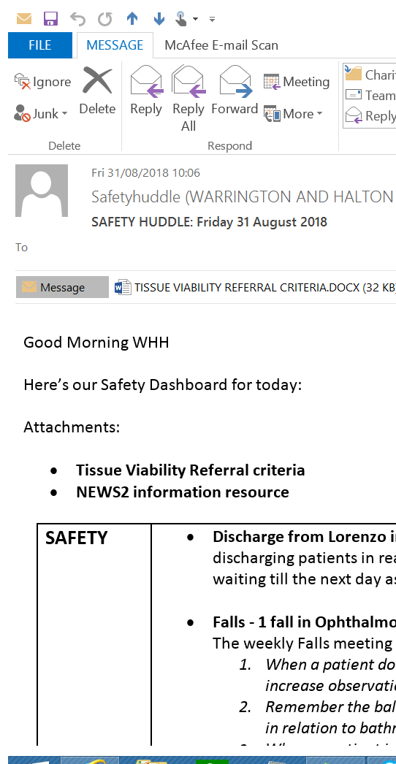
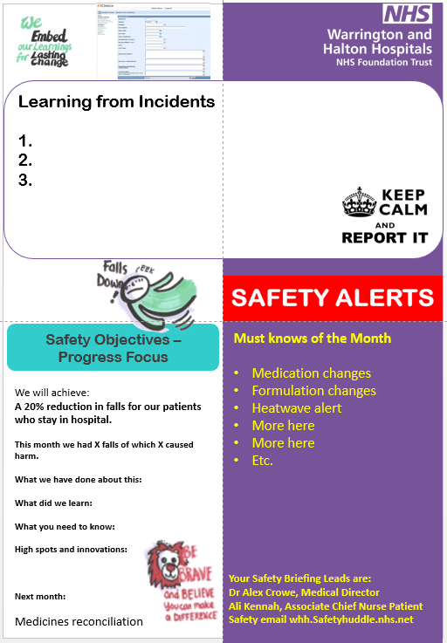
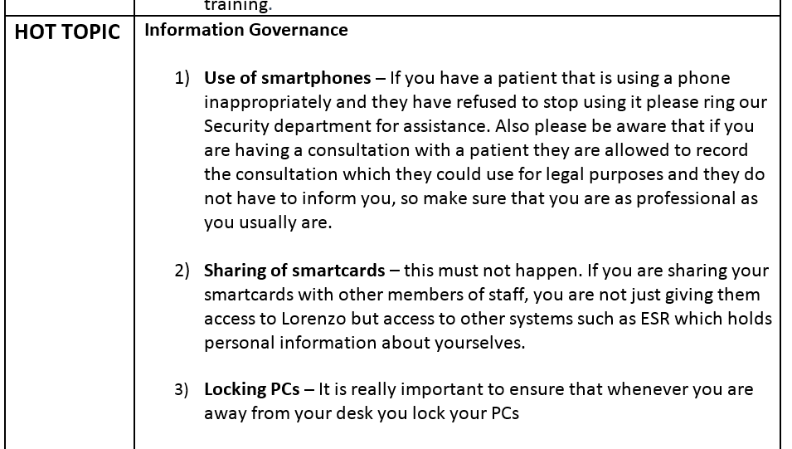
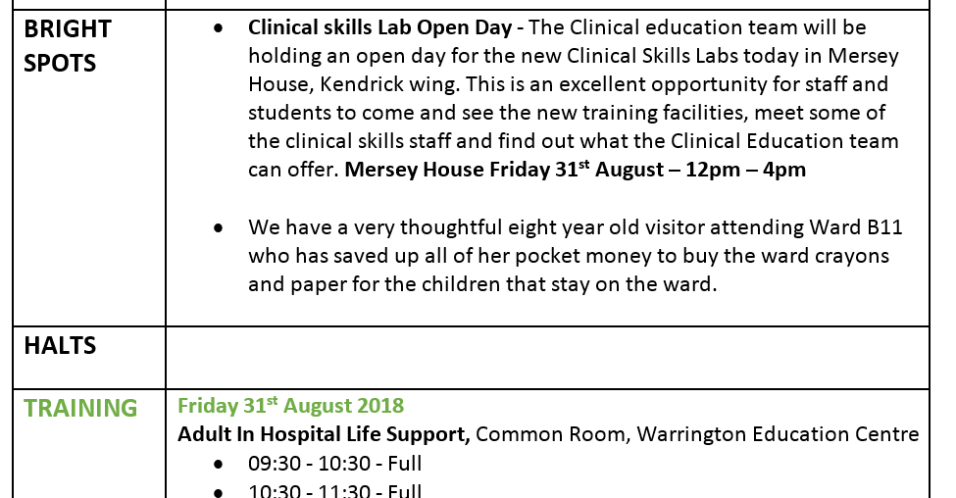
Monthly Briefing launching this month
Safety Bulletin

Slide 21
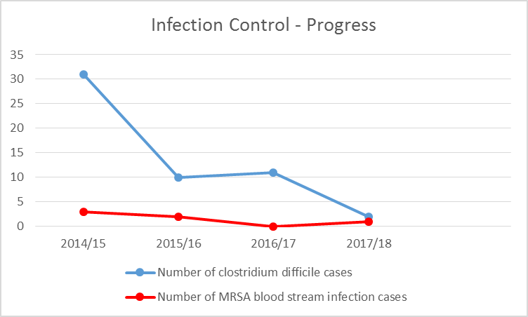
Healthcare Associated Infections
C-Diff target <27
MRSA target 0

Slide 22
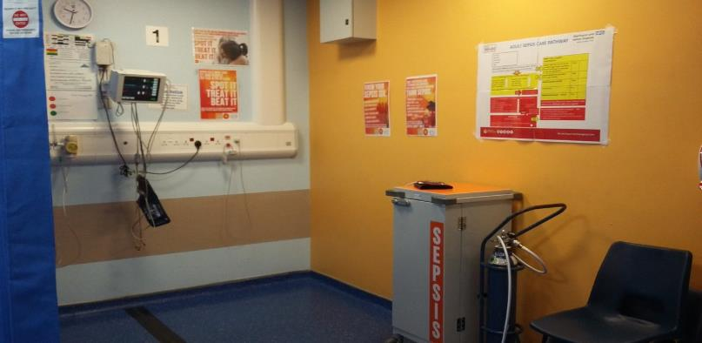
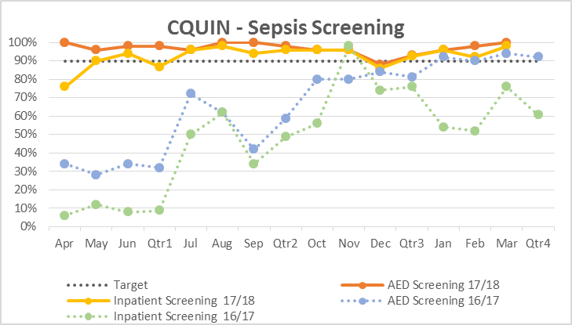
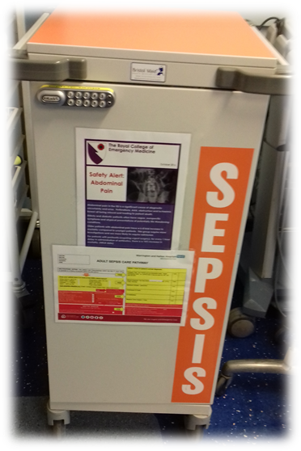
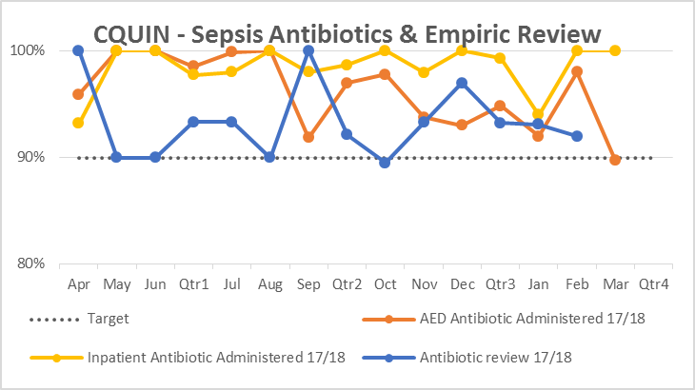
Sepsis Screening and treatment
Major progress year on year on Sepsis screening and timely administering of antibiotics

Slide 23
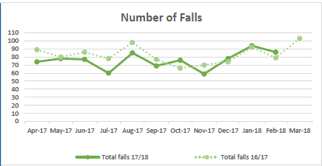
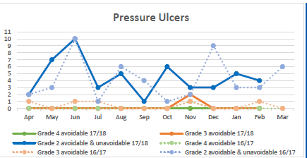
Quality Indicators
 | 2016/17 | 2017/18 | Increase/Decrease
All Falls | 990 | 868 | 12% reduction
Ward only falls | 885 | 753 | 14% reduction

Slide 24
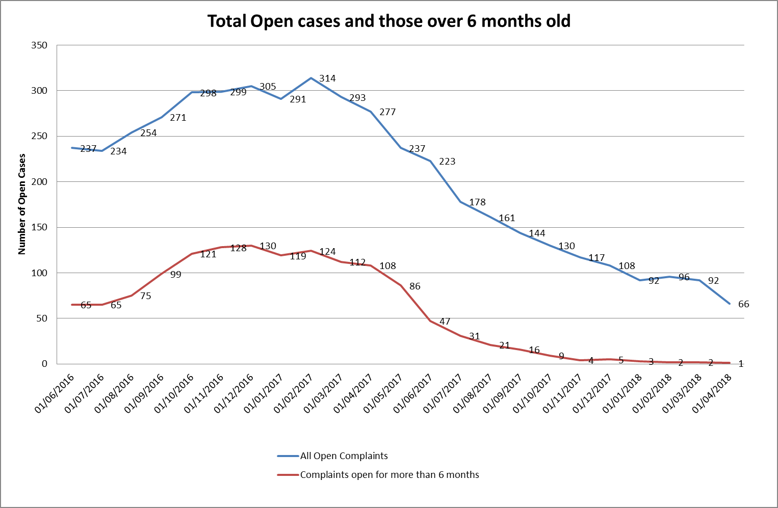
Complaints
Real focus on reducing complaints backlog
At year end no >6months open complaints
Timeliness of responses improving from 27% in Q1 to 50% in Q4 – now working to 100%
New complaints and concerns policy
PALs concerns 1,397, all but 32 resolved
This is so important to ensure that we resolve things as quickly as we can to ensure we learn lessons and implement changes

Slide 25
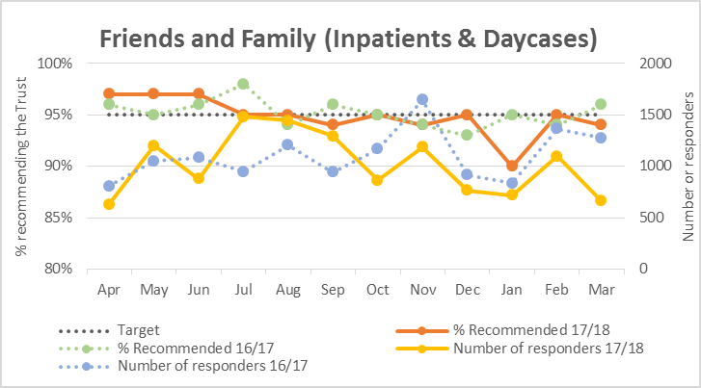
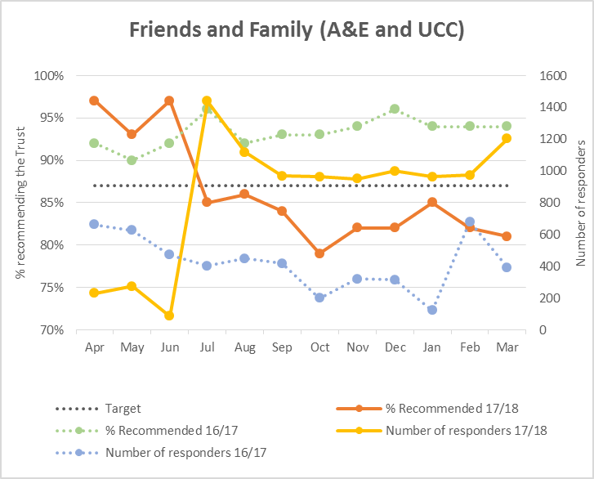
Patient Experience
Introduced FFT by text or automated voice call
Real time data by ward
Enables swift intervention, resolution and learning

Slide 26
WHH Inpatient Survey Analysis (Adults) 2017
The Number of Questions that
IMPROVED since last year
GOT WORSE by 5% or more since last year
WERE NEW this year
SHOWED IMPROVEMENT (improved steadily over 3 years
INDICATE CONCERN (Steadily deteriorated over 3 years)
WHH was in TOP 20% of Trusts
WW was in BOTTOM 20% of Trusts
42
Response Rate 35%
0
7
4
8
9
47% 53%
9
Priority Areas of Focus
Discharge delayed due to wait for medicines / to see doctor / for ambulance
Length of delay in being discharged
Noise at night from other patients on the wards
Emotional support for patients whilst an inpatient
Information given to patients on discharge
….What Matters Most to You?.....

Slide 27
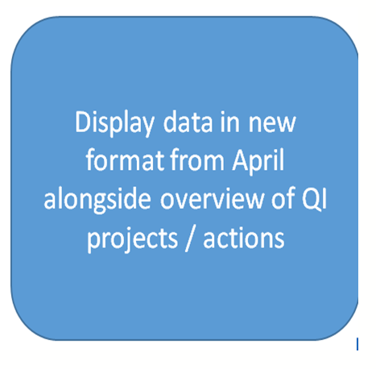
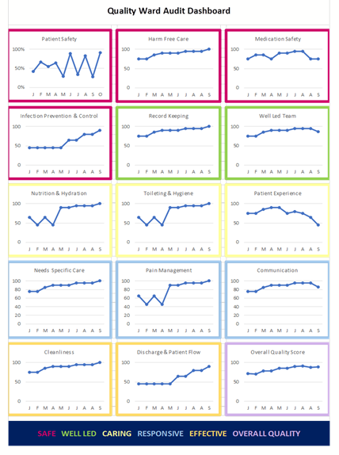
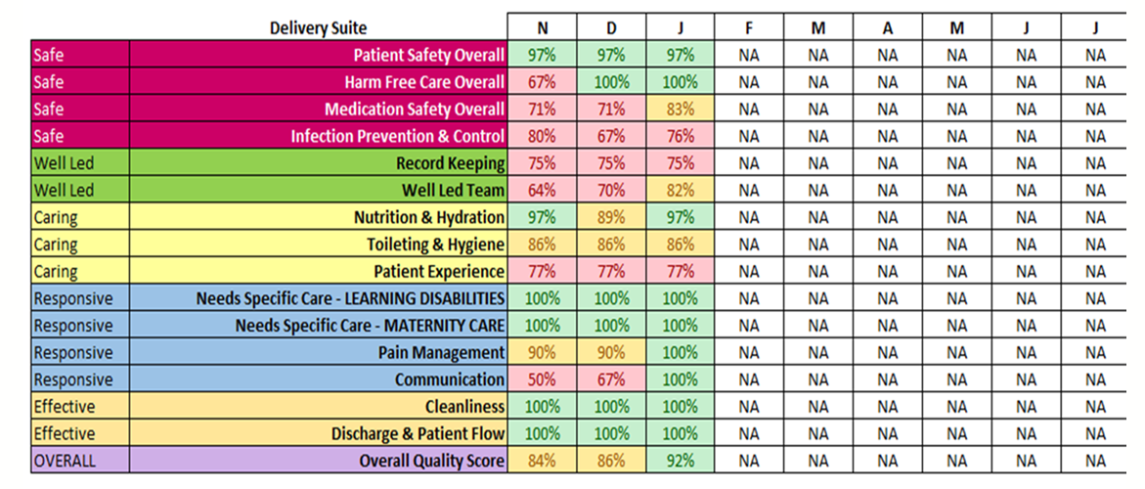
Ward Quality Metrics
Ward Quality Metrics provides a systematic measure of the quality of care delivered at ward level.
Measure standards on core activities, which are aligned to the CQC domains
Metrics designed to inform at two levels in the organisation
Reporting at ward level
Reporting at Trust level
Data is used and reviewed as part of the ward accreditation process

Slide 28
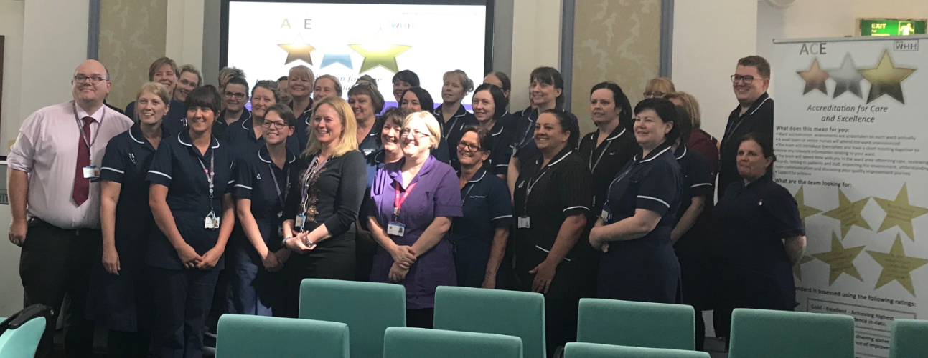
WHH Ward Accreditation Programme
Purpose: To ensure high quality, safe and compassionate care and services.
Process of assurance from ward to board and includes an ‘award status’ based on level of success achieved
Standardised assessment to enable achievement of ward safety/quality standards
Commitment to continuous improvement
Empowering leaders and engaging staff

Slide 29
Quality Academy Our vision is to enable cutting edge research and innovation, embedding excellence in care through continuous quality improvement, working with staff, our partners and the public.
The Trust has launched a Quality Academy – R&D, Knowledge Management, Quality Improvement, Innovation
Promoting partnership working with AQuA, Innovation Agency, Universities
Delivery arm for the Trust quality priorities
Clinical engagement, patient voice to assess improvements made

Slide 30
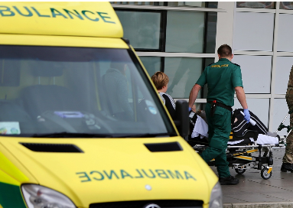
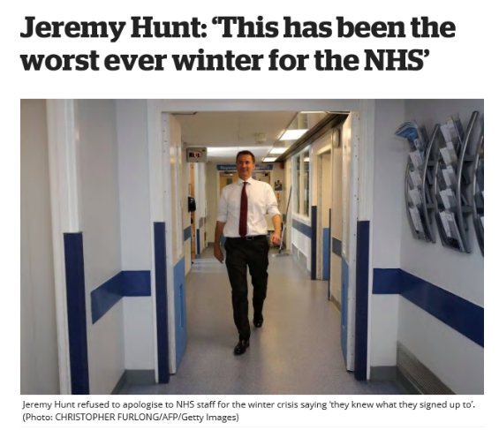
Winter Woes
NHS Cyber Attack
Believed to be the worst winter on record for the NHS, WHH did not achieve the standard, but we did perform better than both the regional and national average
Thanks to a dedicated elective site at Halton, we were able to recommence operations very quickly in January
The NHS was subject to a significant Cyber attack using the Wannacry virus in May
WHH not affected thanks to continuous upgrading and patching of our systems by our IM&T team
Nevertheless we took down our wireless and email systems as a precautionary measures for 72 hours
Patients unaffected

Slide 31
Activity
During the year
A&E Attendances increased by 3.7% non-elective
Admissions decreased by 8.0%.
Activity | 2015/16 | % change 15/16 vs 14/15 | 2016/17 | % change 16/17 vs 15/16 | 2017/18 | % change 17/18 vs 16/17
Elective Inpatient Discharges | 5,461 | -1.2% | 5288 | -3.2% | 4929 | -6.8%
Elective Day Cases Discharges | 31,429 | -4.8% | 31633 | 0.6% | 28926 | -8.6%
Non-Elective Discharges | 38,542 | -3.1% | 42771 | 11.0% | 39670 | -7.3%
New Outpatient Attendances | 117,912 | -4.4% | 109259 | -7.3% | 103,138 | -5.6%
A&E Attendances | 105,450 | 2.8% | 108,889 | 3.3% | 112,928 | 3.7%

Slide 32
The 4-hr Standard
Due to operational pressures we did not achieve the 95% national standard and closed with a performance of 88.67% ytd.
However we out-performed regional peers AND the national average

Slide 33
Referral to Treatment (RTT)
We consistently saw more than 92% of our referred patients within the 18 week standard

Slide 34
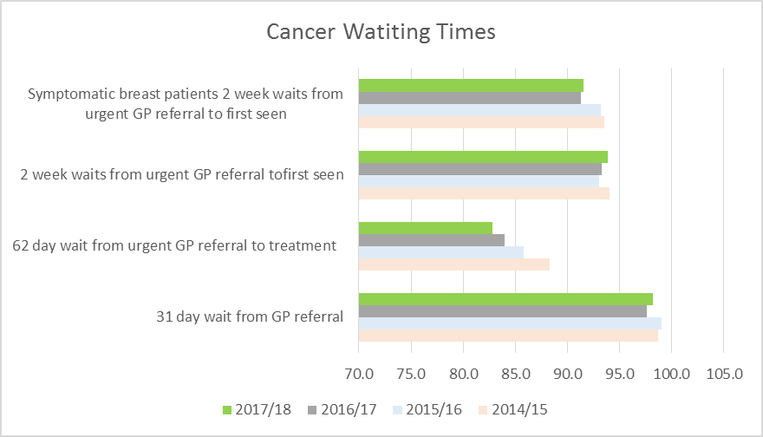
Cancer Referrals waiting times
Target
2017-18

Slide 35
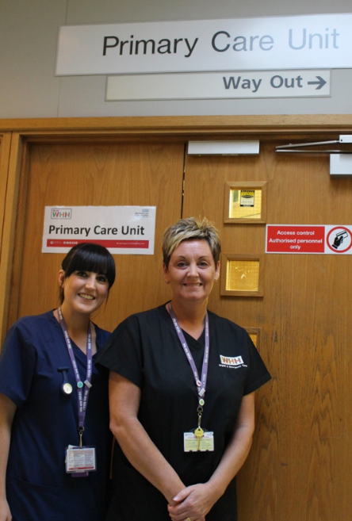
Primary Care Streaming Facility opens
Thanks to a £1m grant from the Department of Health patients arriving at Warrington Hospital’s A&E are now triaged and seen in the ‘Right Place, First Time’ including our new Primary Care Streaming Facility
This reduces pressure on our Majors and Minors units
The Funding was for estates work only

Slide 36
Finance Review Andrea McGee, Director of Finance & Commercial Development

Slide 37
Financial Position
Narrative | Budget | Actual | Variance
 | £m | £m | £m
Operating Income | 234.1 | 234.7 | 0.6
Operating Expenditure | -234.2 | -246.4 | -12.2
Finance Costs | -3.7 | -3.0 | 0.7
Deficit excluding exceptional items | -3.8 | -14.7 | -10.9
Exceptional Items | 0.0 | 0.4 | 0.4
Deficit including exceptional items | -3.8 | -14.3 | -10.5
We ended the year with an operating deficit of £14.7m, excluding exceptional items
The deficit includes efficiency savings for the year of £5.1m
The Trust received £2.5m of Sustainability and Transformational Funding and received a bonus of £1.8m
Exceptional items relate to the reversal of impairment of fixed assets following an asset revaluation exercise

Slide 38
Where did the money come from?
A few facts….
The total operating income generated is £234.7m
The largest source of income is clinical income at £208.0m (88.6%) with the main commissioners being Warrington CCG, Halton CCG, St Helens CCG and NHS England
The largest source of non clinical income is for education and training at £9.5m from Health Education England
Non clinical income also includes income related to staff recharges, clinical tests, catering, estates recharges, lease income and several other services.

Slide 39
What was the money spent on?
A few facts….
Our total operating expenditure is £246.4m
The largest area of expenditure is payroll at £173.7m (70.5%)
We employed an average number of employees equivalent to 3,578 staff, with clinical and support staff accounting for 2,720 (76%) and non clinical staff 858 (24%)

Slide 40
Cost Savings
We delivered efficiency savings of £5.1m from a number of initiatives including workforce redesign, improved utilisation, bed reductions, better procurement, temporary staffing reductions and drug usage and price reductions.

Slide 41
Capital Investments
We invested £5.8m in capital assets to improve the services and environment for patients, visitors and staff:
Investment | £m
Medical Equipment | 1.8
Information Technology | 1.3
Site Improvements | 1.7
Health & Safety / Legislative Compliance | 1.0
Total | 5.8

Slide 42
Medical Equipment
£1.8m was invested in a range of medical equipment. The main items of equipment included:
CT Scanner
Mobile X Ray Machine
Radiology Image Intensifiers
Anaerobic Cabinet
Theatre Operating Tables, Induction and Diathermy Machines
Intensive Care Unit Ventilators and Monitors
Neonatal Incubator
Dental Suite Upgrade and Chairs
Spacelab Telemetry System
Pathology Blood Fridge and Cell Saver
Life Pak Defibrillators

Slide 43
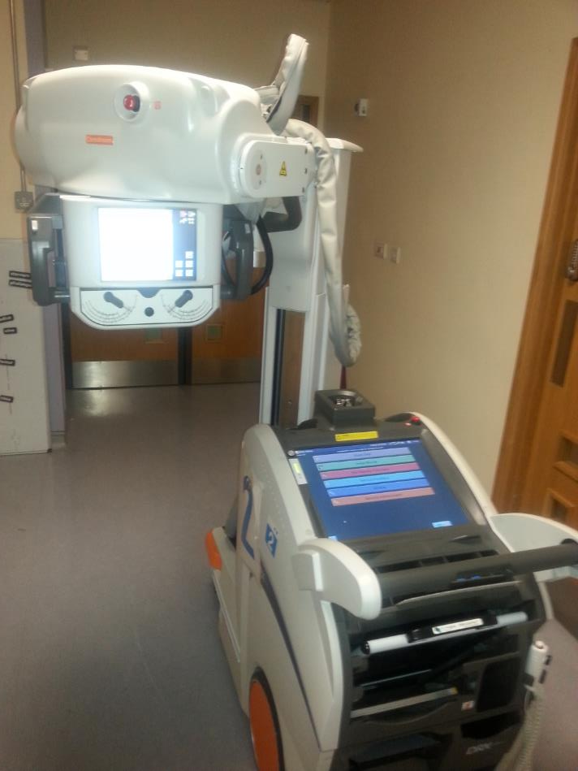
CT Scanner
Mobile
Scanner

Slide 44
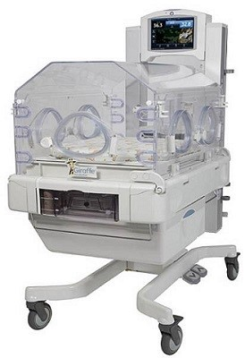
Theatres Operating Table
Neonatal Incubator

Slide 45
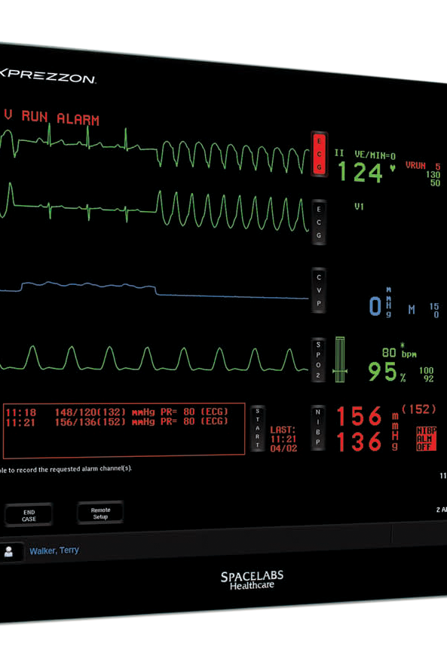
ICU Ventilator and Monitor
Spacelabs Monitoring Units

Slide 46
Information Technology
£1.3m was invested in a range of IT equipment
Improvement to server infrastructure
Implementation of electronic patient record - Lorenzo - Phase 2 (including optimisation)
Expansion of Storage Area Network
New desktops and devices
Introduction of NHS mail
Installation of Virtual Desktop Infrastructure
Software upgrades including Health & Safety System, A&E Coding
Improve network resilience

Slide 47
Estates Works
Introduction of a Primary Care Streaming Unit
Introduction of a Frailty Assessment Unit
Refurbishment of Radiology Reporting Room
Installation of new Lighting and Flooring
Installation of Fire Suppression System, Doors and Alarms
Upgrade of Electrical Infrastructure works
Upgrade of Water Safety Compliance system
Upgrade of Building Management System
Refurbishment of buildings and roofs
Repair of footpaths and pavements
Replacement of Dishwashers, Food Trollies and Ovens
£2.7m was invested in schemes to deliver site improvements and comply with health and safety standards and legislation.
The main items included:

Slide 48
Cash Flow Statement
Under the terms and conditions of the working capital loan the Trust is required to maintain a minimum cash balance of £1.2m. The cash balance at 31st March 2018 was £1.2m with the key movements in the year summarised in the table below:
Narrative | £m
Opening balance as at 1st April 2017 | 1.2
Deficit | -14.7
Non cash items included in deficit | 5.2
Loans received from Department of Health | 17.3
Capital expenditure | -5.8
Other movements | -2.0
Closing balance as at 31st March 2018 | 1.2
The £17.3m loan was to cover the 2017/18 deficit and aged creditors
In 2015/16 the Trust secured a £14.2m loan to cover the annual deficit which is repayable in 2018/19. The Trust is in discussions with NHSI regarding a repayment plan.

Slide 49
Use of Resources Risk Rating and Audit Opinion
The Trust recorded a Use of Resources Rating score of 4
The Annual Accounts were signed off on the basis of a ‘going concern’
The Trust received an unqualified audit opinion from its External Auditor (Grant Thornton) with no concerns raised during the audit and stated that the financial statements represented a true and fair view of the Trust’s affairs

Slide 50
Financial Outlook
In 2018-19 we have planned for a deficit of £16.9m (including Sustainability & Transformational Funding of £4.9m)
Investment of £3m in Nursing and Health Care Assistants
Investment of £0.8m in new electric beds over next three years
Investment in staff, equipment and facilities to support the progression of CQC rating to GOOD
We have applied for a working capital loan of £16.9m to maintain liquidity
We have agreed a sustainability contract with our main commissioners to provide financial coverage whilst we deliver changes that will ensure services remain clinically and financially sustainable.

Slide 51
Lead Governor’s Report Mr Norman Holding, Public Governor Burtonwood, Winwick, Whittle Hall, Westbrook

Slide 52
Membership Report
Latest data source NOMIS | Membership - Public 2018
Warrington and Halton Boroughs | Target | Actual% | Actual #
Population | 13192 | 84.6 | 11166
Males | 49.3% | 34.4 | 3840
Females | 50.7% | 65.6 | 7326
15 to 19 | 5.9% | 0.3 | 35
20+ | 75.8% | 99.7 | 11131
White | 95.6% | 95.7 | 10700
White Non British | 2.2% | 1.5 | 166
Mixed/multiple ethnic groups | 1.1% | 0.5 | 52
Asian/Asian British | 1.8% | 1.6 | 176
Black/African/Caribbean/Black British | 0.3% | 0.2 | 22
Other ethnic group | 0.2% | 0.5 | 50
Historic Target- 4% of population which is equivalent to 13192 members – under represented BUT Focus now is on being representative rather than numbers
We are under represented by men by at least 15%
We are under represented by 15-19 year olds by at least 5%
We are most under-represented by white non-British and Mixed ethnic groups
New Membership Strategy will focus on under-represented groups
“Your Hospitals” published 3 times per year and posted once to households each summer

Slide 53
Governor Activity
November 2017 Governor Elections
7 Public Constituencies eligible for election – 4 new Governors elected, 3 constituencies remained vacant
2 Staff Governor Roles eligible for election – 1 new Staff Governor elected, 1 Staff Governor elected for a second term.
June 2018 Governor Elections
8 Public Constituencies eligible for election (Rest of England & Wales constituency to be made up of two Governors)
- 4 new Governors elected
- 2 Governors elected for a second term
- 3 constituencies remained vacant

Slide 54
Activity 2017/18 continued
Council of Governors
16 Public Governors (3 Vacant)
5 Staff Governors
6 Partner Governors
Governor led Groups
Quality in Care
Governor Engagement Group
Meetings attended
Patient Experience Committee
Charitable Funds Committee

Slide 55
Council of Governors Initiatives
Chairman’s Brief – regular informal meetings with the Chairman of the Trust
Monthly Chairman and Lead Governor one-to-one meetings
Attendance at the re-introduced North West Governors’ Forum
Review of and amendment to the Trust’s Constitution – specifically related to public constituencies and timing of Governor Elections
Introduction of bi-annual Governor and Non-Executive Director meetings
Governor Training - Internal and External

Slide 56
Governors’ Engagement Group
Work Plan
Governor Recruitment
Governor Promotion
‘Beat the Scrum’ campaign
‘What Matters to Me’ Conversation Cafes
NHS 70th Birthday Celebrations
Community Engagement
Trust Newsletter

Slide 57
Governors Quality in Care Group
Agenda
Trust Quality Dashboard
Feed Back from Board Quality Committee
CQC Report Updates
Quality Accounts
Complaints
Family & Friends
Governor Observations

Slide 58
Governor Observation Visits
How: Locations for visit often signposted by complaints.
Completion of reports resulting in a ‘confidence’ score
Frequency: Approx. once a month
Objective: Obtain patients and staff views and to better understand, first-hand, the Trust operations. Gain first impressions and review wards/departments against CQC inspection criteria (Safe, Caring, Responsive, Effective & Well Led)

Slide 59
Areas visited during the past year
Orthopedic Out-Patients
& Physiotherapy
B1 Intermediate
Care Halton
C23 Maternity
C23 Cardiac
A8 General
Medical
PIU Halton
Accident & Emergency
Warrington
B3 Surgical Halton
CMTC Halton
Coronary Care Unit
C20 Gynecology

Slide 60
Why do we do it?
Effectively fulfil the role of Governor by holding the non-executive directors individually and collectively to account for the performance of the board of directors
To feed back information about the Trust, its vision and its performance to members and the public and the stakeholder organisations
To represent the interests of the members of the Trust as a whole and the interests of the public
A chance to get closer to the “coalface” rather than in the board room
Identify and report any areas in need of improvement
Patients and staff get to meet their Governors
Because we enjoy doing it!

Slide 61
Break (15mins)

Slide 62
Forward View 2018-19 Mel Pickup, Chief Executive
Getting to ‘Good’ moving to OUTSTANDING

Slide 64
Our new quality strategy

Slide 65
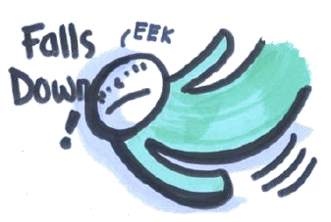
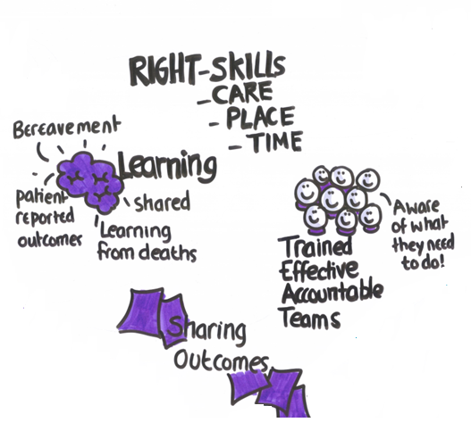
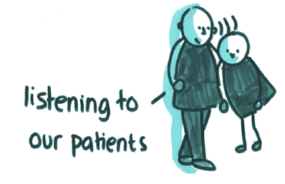
Our new quality strategy

Slide 66
Continue to benchmark ourselves nationally
Best UK employer of the year
Best employer for staff recognition
Best workplace for learning and development (2!)
Introducing a multi-disciplinary core competency framework
Investing in the workforce of the future. Developing a multi-professional aspirational leadership programme
4. Workforce team of the year
Category: Emergency and Critical Care:
Primary Care Screening
Category: Patient Safety Improvement:
Sepsis redesign challenge

Slide 67
Becoming sustainable as a system

Slide 68
Vision
A health and social care system to be proud of
Agencies and services working together with local residents
Make better use of resources
Focus on primary care – and prevention
Empowering people – promoting self-care
Supporting the most needy
Doing things differently
A great place to work
A healthier, happier Warrington
Integrated health and social care
Population-based model
Based around primary care: 28-4-1 model
A tailored offer
Out-of-hospital care
Warrington Hospital
Accountability and regulators

Slide 69
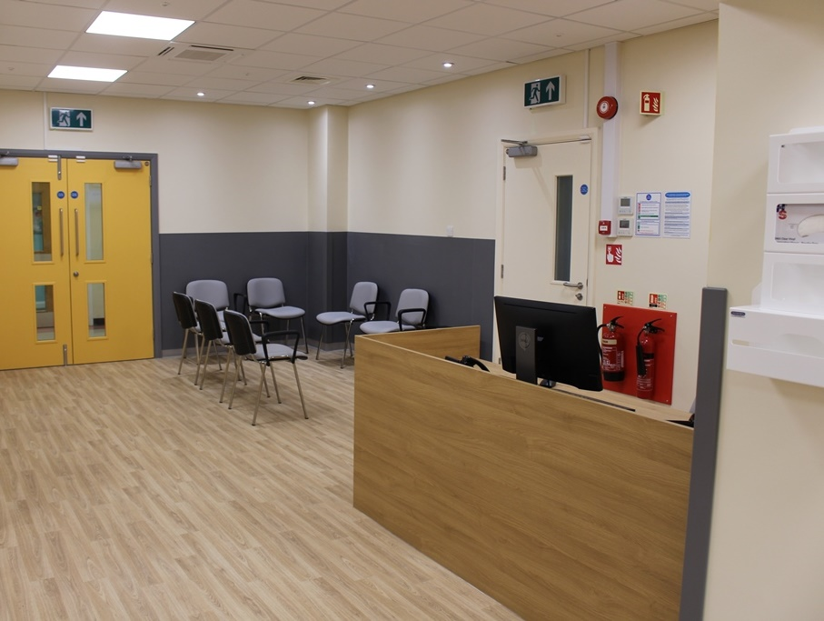
Case study - FAU

Slide 70
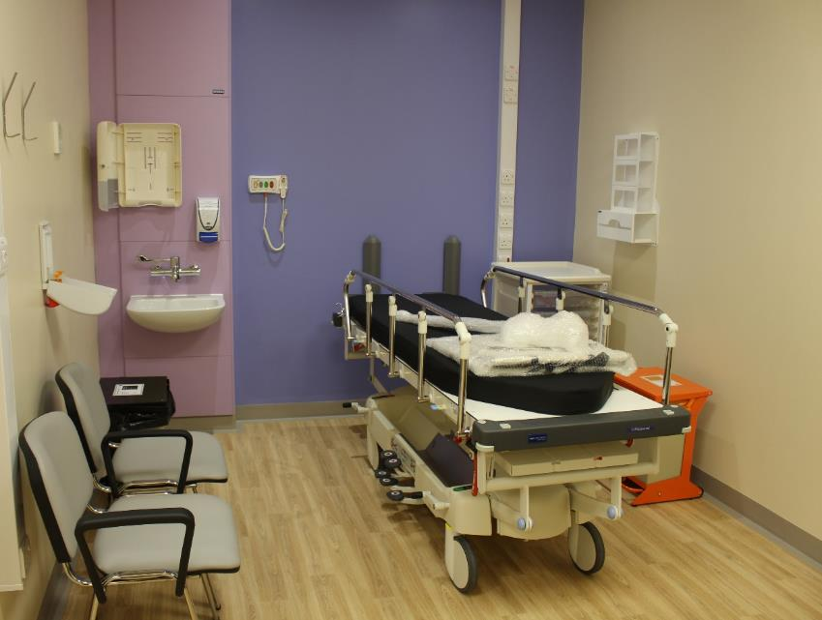
Phase 1 Reduce avoidable admissions in frail elderly
Purpose-build environment adjacent to A&E
‘Home First’ philosophy - focus on patients’ strengths – what they can do
Multidisciplinary team (medics, nurses, therapists, pharmacist, social care professionals, voluntary sector)
Streamed directly from A&E triage within 30mins of arrival - no beds!
Pilot phase successful, moved to 4-days/wk service
Average LoS 10 hours, 86% all patients seen sent home safely!

Slide 71
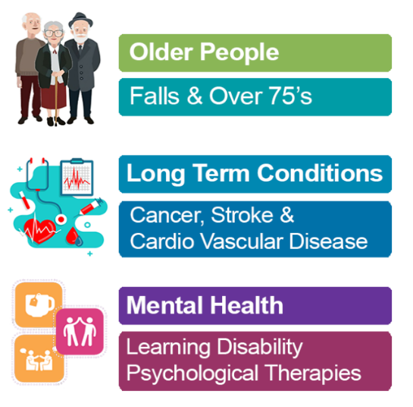
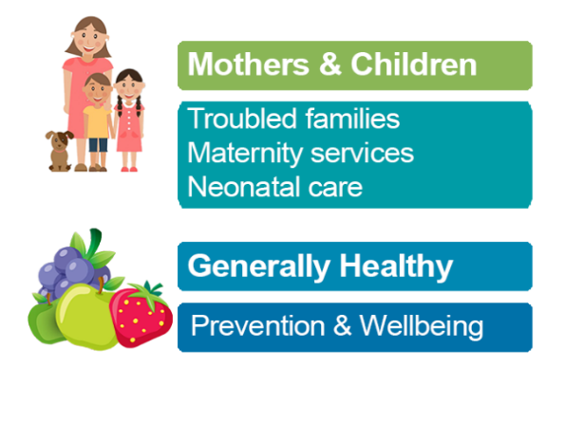
Vision:
'Working better together to improve the care and wellbeing of the people of Halton'
One Halton Objectives:
To work better together regardless of discipline;
To find or identify those 'hidden' people who don't access care;
To treat and care for people at the right time, in the right place by the right people;
To help people stay healthy and keep generally well;
To provide the very best in care, now and in the future.

Slide 72
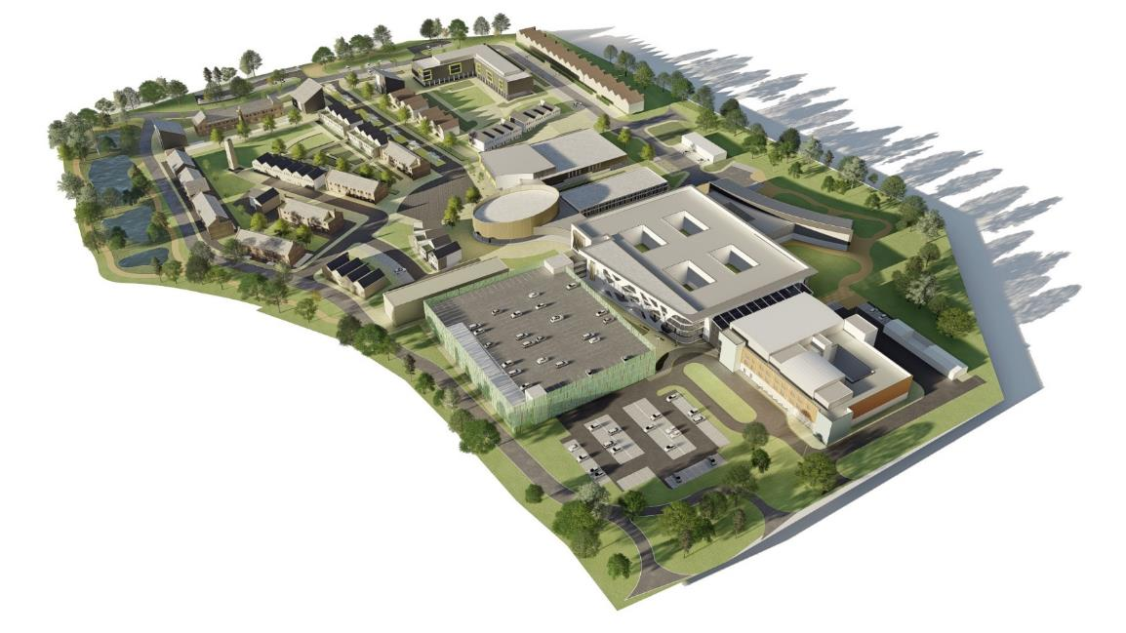
At the heart of Halton Healthy New Town is the development of the Hospital and Wellbeing Campus
A complete redevelopment of the Halton Hospitals site
Bid submitted for £40m capital STP funding – 3rd time lucky?
Redevelopment would release unused NHS land on site for construction of a range of health and wellbeing facilities

Slide 73
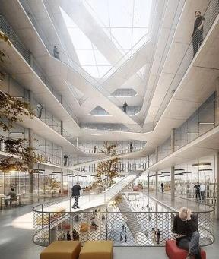
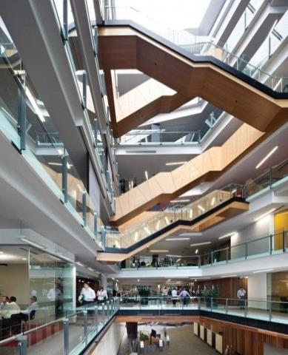
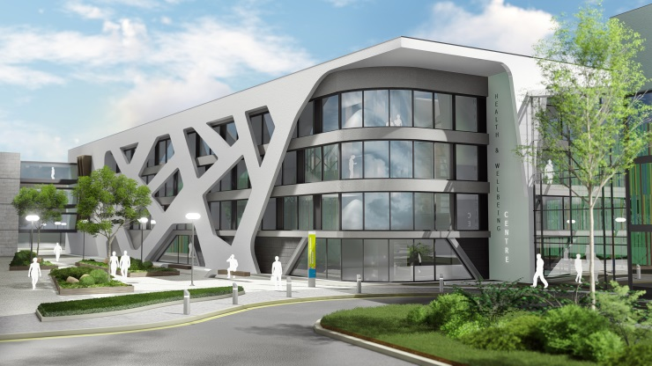
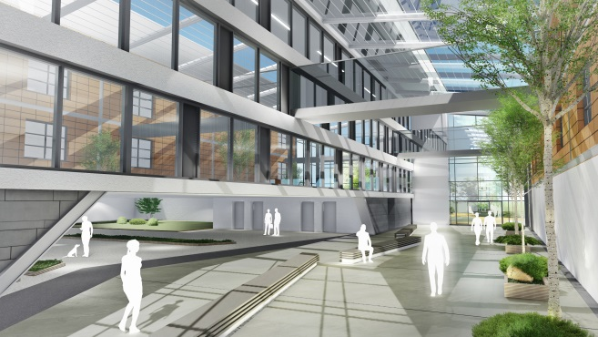
We intend to deliver the same great services from a modern, efficient building
The Campus design allows us to deliver extra services from other buildings on site (for example step-down care)

Slide 74
An Integrated Community Resource

Slide 75
A New Warrington Hospital
Engage an external independent advisor(s) feasibility study
Visit a number of reference sites
Receive a plan from the independent advisor(s)
Explore any current vacant or under-utilised local authority or NHS facilities
Involve Patients, Staff, Public, Stakeholders at earliest opportunity
Creating an integrated social asset for Warrington

Slide 76
In this 70th year of our glorious NHS WHH is on the journey to outstanding Thank you for continuing to support and believe in us.

Slide 77
Q&A Steve McGuirk CBE DL, Chairman

